Slide 1

Heart Disease Prediction

Slide 2
Things we know that the data confirms
Being male increases risk of CVD
Not having diabetes, anaemia or smoking helps a little bit
Higher CK, lower EF, higher Cr
Older

Slide 3
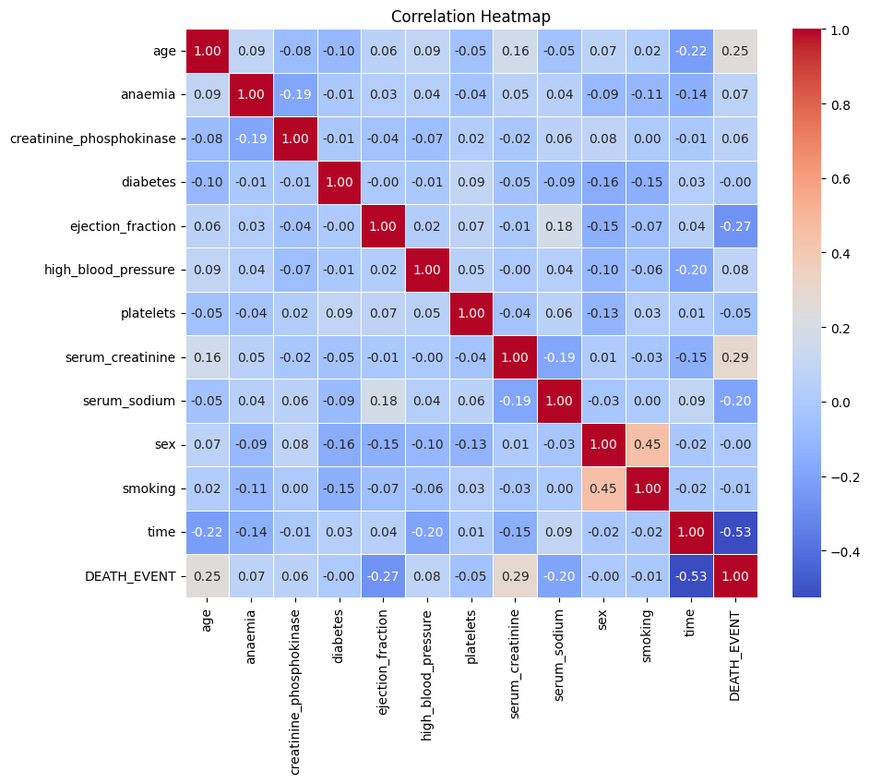

Slide 4
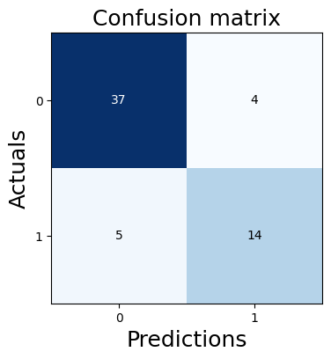
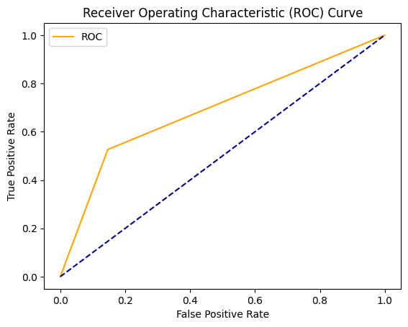
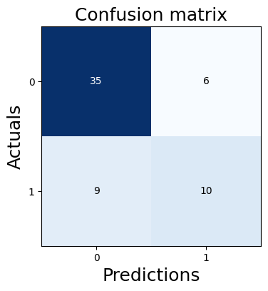
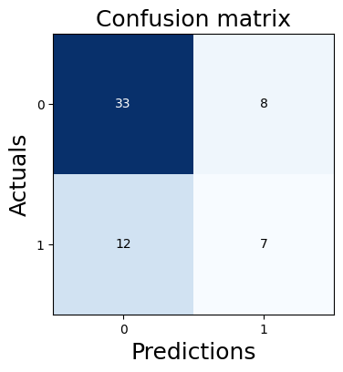
Steps taken – using all data
Standard Scaler
Logistic regression
Accuracy 85%
Naïve Bayes
Accuracy 75%
K-Nearest Neighbours
Accuracy 75%

Slide 5
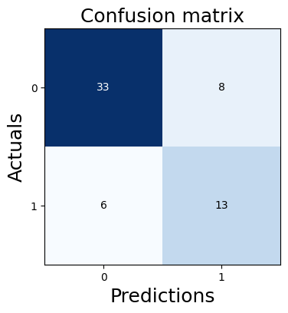
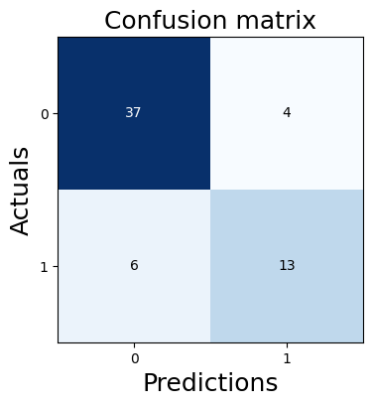
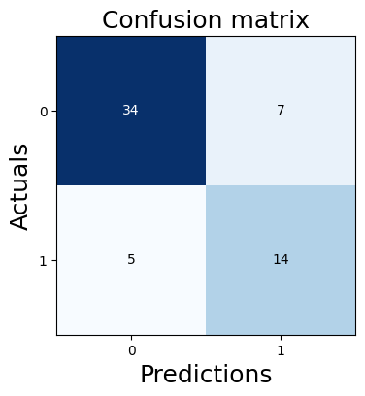

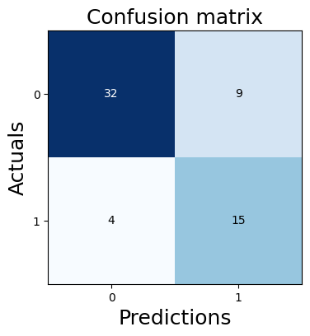
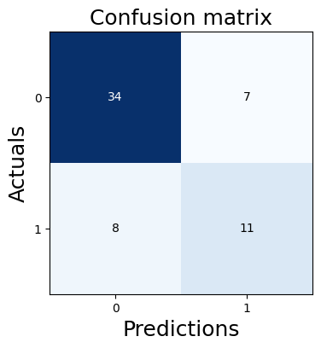
Decision Tree
Gini – Accuracy 76%
Entropy – Accuracy 77%
Depth 3 – Accuracy 78%
SVM
Linear – Accuracy 83%
Sigmoid – Accuracy 80%
Depth 3 – Accuracy 75%

Slide 6
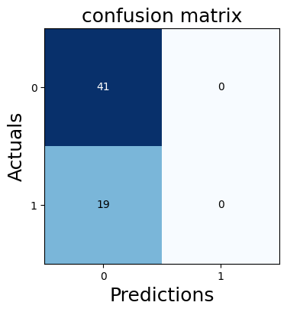
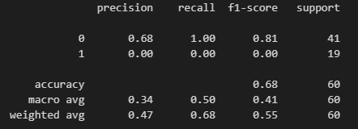
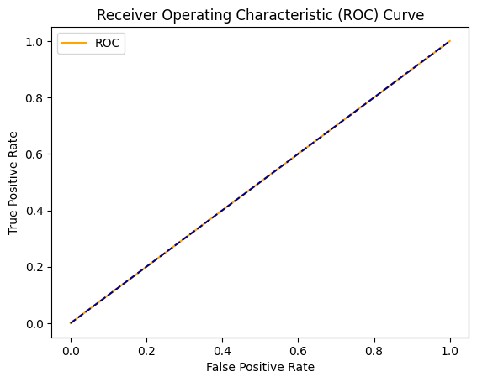
ANN

Slide 7
What to do next
Models have been run on all features – use less features
Work with different number of layers in ANN – different activation, epochs etc
Use a different scaler and run models again
Thank you!

